Slide 1
CARTO Spatial Data Science Bootcamp
Spatial Python
Sep 14th, 2023, Toronto

Slide 2
The Agenda
01
03
02
04
Introduction
Geospatial Python
What is Python
Workshop

Slide 3
Speaker Introduction
Thomas Lillo
Jesse Terhorst
Intermediate Software Developer at Environics Analytics
Data Specialist with the City of Toronto

Slide 4
Our Learning Goals
01
02
03
Learn About Python & Common Geospatial Use Cases
Become Familiar With Popular Geospatial Resources
Get Started Writing Python to do Geospatial Data Science

Slide 5
Why Python?
Versatile & Accessible
Libraries and Tools
Strong Community
Notes:
Known for its simplicity and readability.
Lots of libraries and tools specifically designed for data science.
Large and active community that continuously ,contributes to development and improvements
https://www.ibm.com/blog/python-vs-r/
Why might you choose python over R?

Slide 6
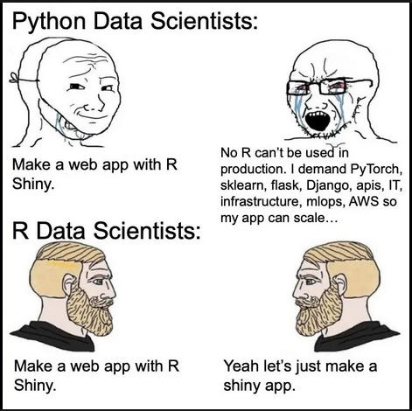
Why not R??

Slide 7
Why not R??
Python | R
General purpose language for doing data science, web development, and embedded systems. | Used mainly for statistical analysis and for graphical techniques.
For application development as well as data science. | For complicated mathematical calculations and statistical tests.
Larger community with more diverse package ecosystem. | Smaller community with more focused support for data analysis.

Slide 8
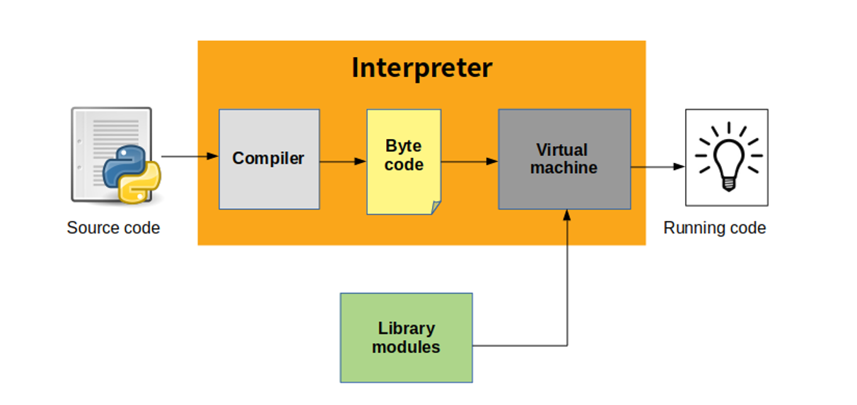
How Python Runs
Python is an interpreted language, it comes bundled with the python interpreter that turns your code into something the computer can execute (machine code) and runs it.

Slide 9



Popular Tools When Working with Python
Anaconda provides a convenient way to manage environments and packages.
Jupyter Notebooks provide a platform for running python code with embedded documentation.
Docker containers provide a consistent environment across platforms for running code.

Slide 10
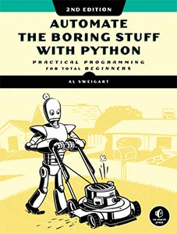



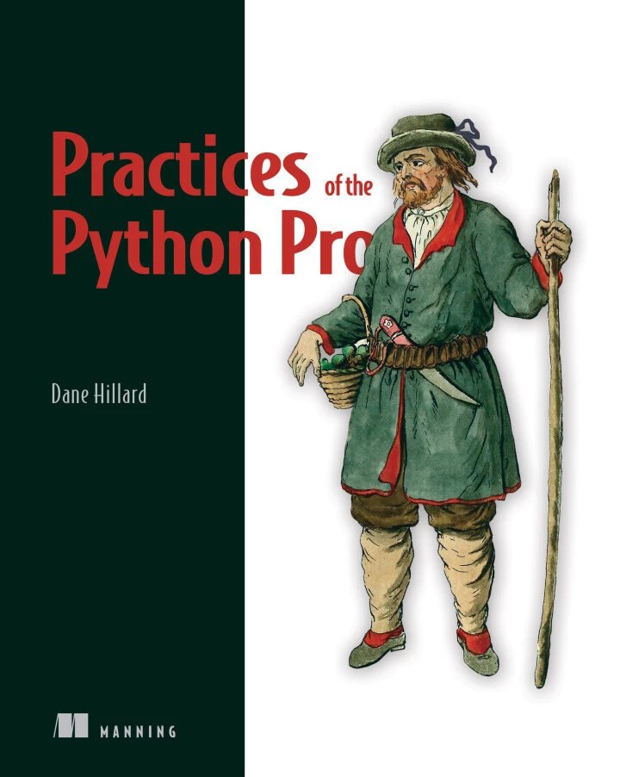




Where to Really Learn Python
After the Basics
geo-python-site.readthedocs.io
automatetheboringstuff.com
Blog + Podcast + Courses
coursera.org/learn/learn-to-program
codecademy.com/learn/learn-python-3
Notes:
For the sake of time, we won’t focus on the core python language and scripting, but skip directly to the spatial data science resources and tools available in the python ecosystem

Slide 11
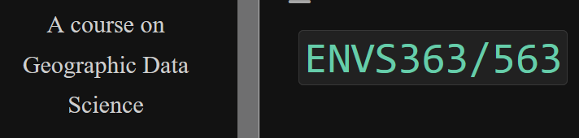

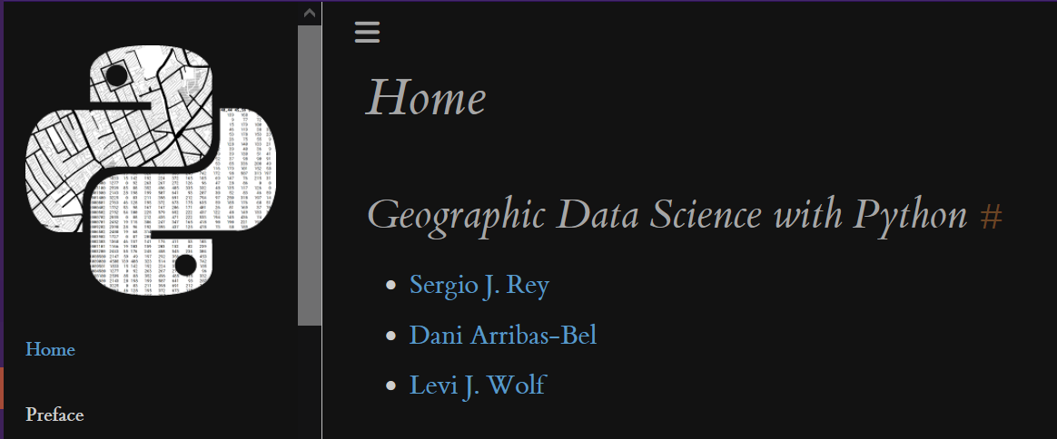
Even more high quality resources for Spatial Python!
University of Liverpool Open Course:
https://darribas.org/gds_course/content/home.html
Free online textbooks
https://pythongis.org/
https://geographicdata.science/book/intro.html
Notes:
This book is good too, but in R :(
https://mgimond.github.io/Spatial/index.html

Slide 12
— CARTO
“Spatial Data Science (SDS) is a subset of Data Science that focuses on the special characteristics of spatial data using modelling to know where and why things happen”

Slide 13
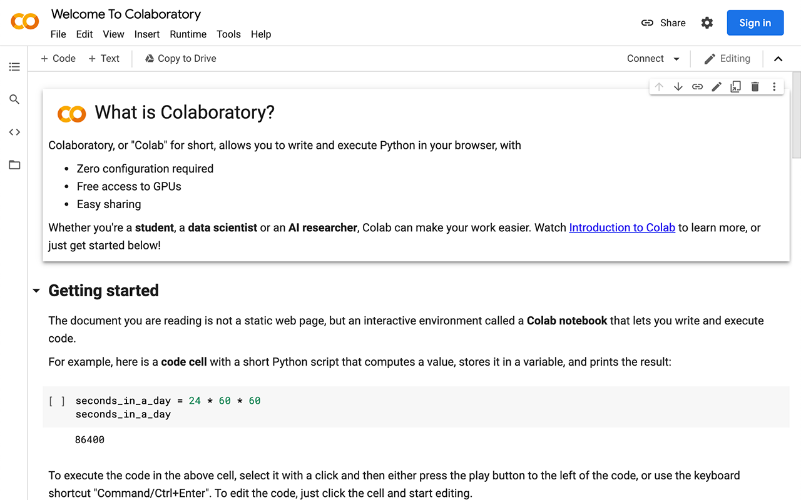
How We’ll Run Our Code
Google provides a python notebook environment right in your browser with their Colab service.

Slide 14
Colab Link 1
http://tinyurl.com/spatialpylibs
https://colab.research.google.com/drive/1TYQ0c2bnWPFN8vrhh5El-vgaoIoCGcrq?usp=sharing

Slide 15
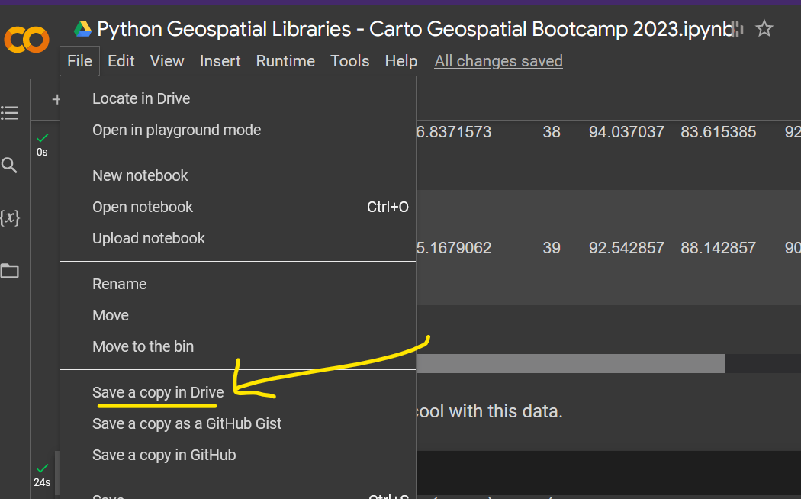
http://tinyurl.com/spatialpylibs

Slide 16
We stand on the shoulders of giants.
Popular Geospatial Libraries

Slide 17
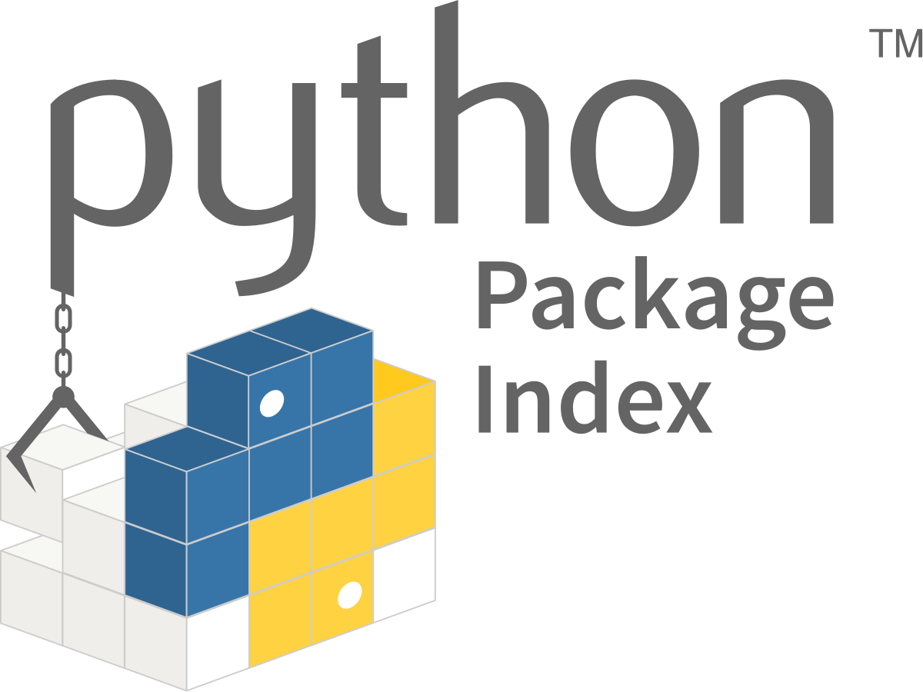


What is a python library?
A library is an umbrella term for a collection of python code that you can use in your own programs.
Python comes bundled with a number of “standard libraries” and others can be installed from the internet using a package manager like PIP.
Notes:
The Python Package Index, abbreviated as PyPI and also known as the Cheese Shop, is the official third-party software repository for Python. PyPI is run by the Python Software Foundation, a charity.
A library is a collection of packages.

Slide 18
Types of Geospatial Python Libraries
Vector Data Handling & Analysis
Raster Data Handling & Analysis
Spatial Analysis & Visualization
Mapping & Geocoding
GIS Software Interfaces

Slide 19
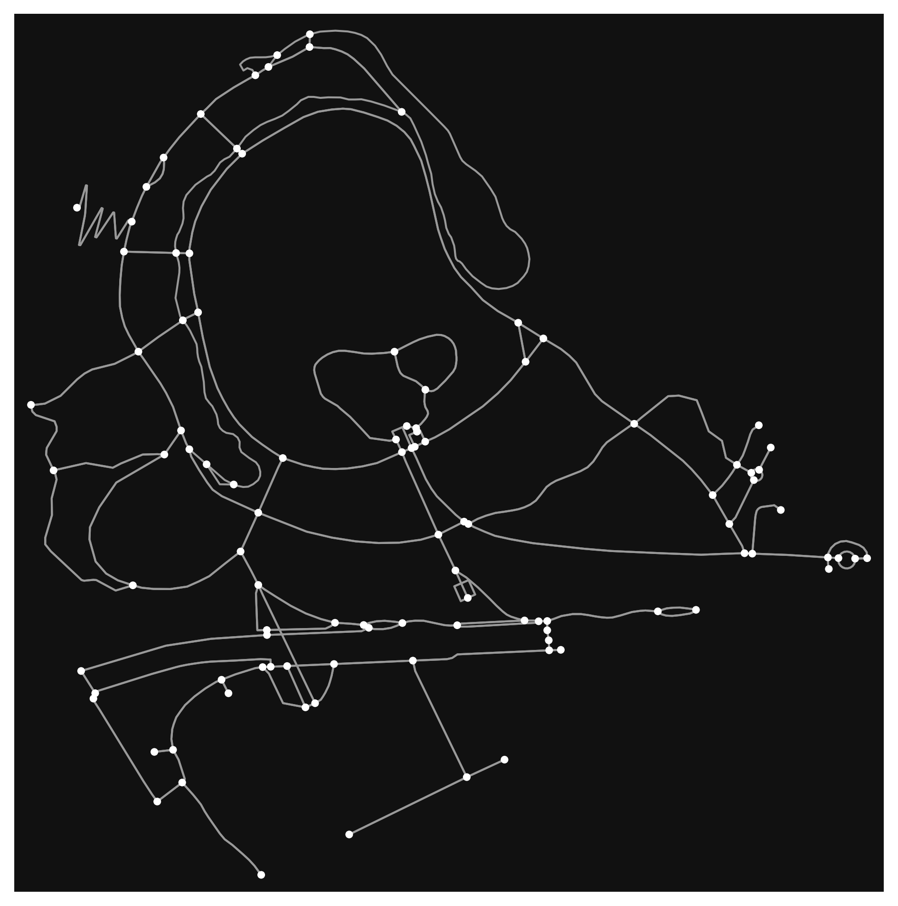
Geospatial Data Structures in Python
Tables (Vector Data)
Rows are points/lines/polygons
Columns provide metadata or weighting for features
Raster / Surfaces (Raster Data)
A continuous area divided into pixels
Networks
Spatial graphs highly the connections between nodes
osmnx.plot_graph(graph);
Notes:
Some things that you’ll see as we review some of the popular libraries

Slide 20
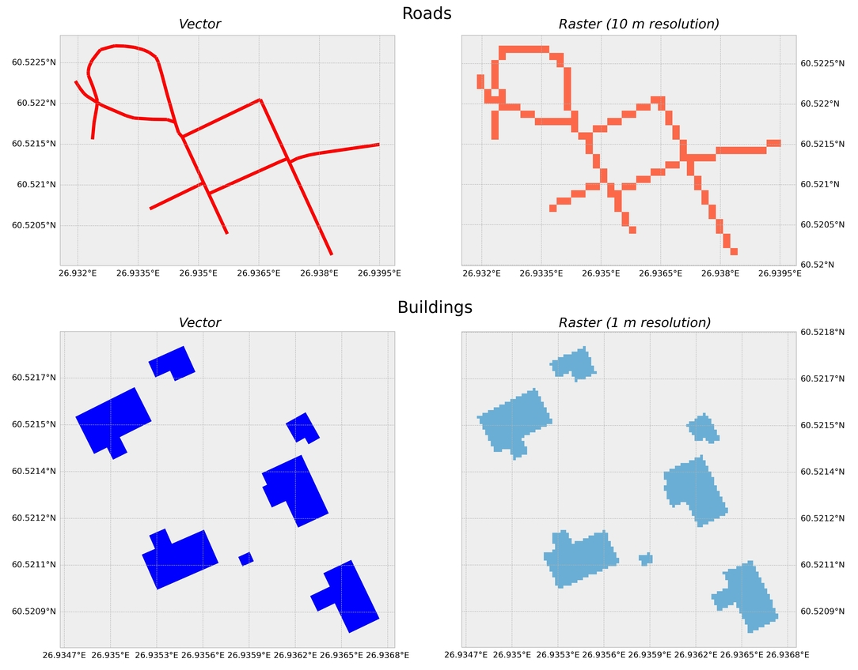
A Refresher on Vector & Raster

Slide 21
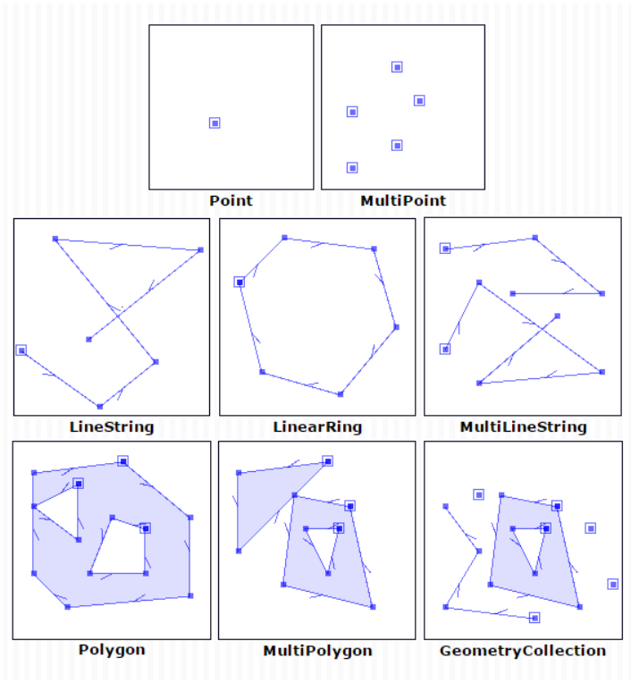
Shapely - Vector Data & Analysis
For manipulation and analysis of geometric objects using the widely deployed geometry library GEOS (the engine of PostGIS).
Shapely is particularly good for tasks that involve geometries like points, lines, and polygons, supporting operations like buffers, unions, intersections, and differences.

Slide 22


Fiona & PyProj - Working with Geographic Files
Fiona is used for reading and writing vector data, built on top of the powerful GDAL (Geospatial Data Abstraction Library). It can handle multiple formats like Shapefiles, GeoJSON, and others.
PyProj is used for cartographic projections and coordinate transformations, often in combination with other geospatial libraries like Fiona and Shapely.

Slide 23
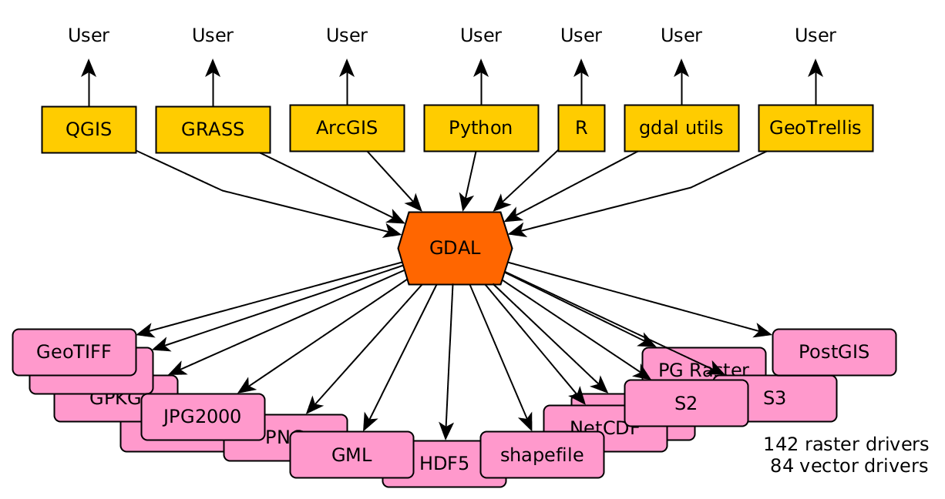
What is GDAL (Geospatial Data Abstraction Library)?
GDAL is a translator library for raster and vector geospatial data formats.
Written in C/C++ and Python, it comes with a variety of useful command line utilities for data translation and processing.
Many python packages are build on top of GDAL!

Slide 24
But what if I just have an address, how do I project that?

Slide 25
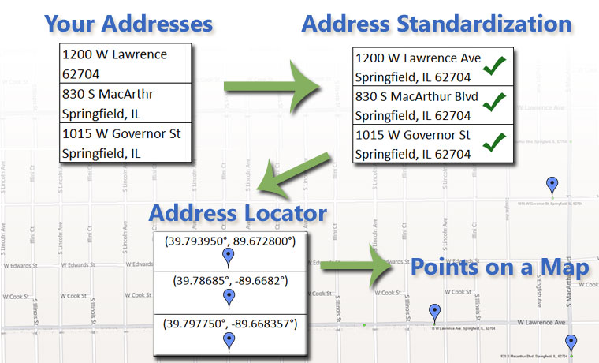
What is Geocoding? I Thought We’re Coding In Python.

Slide 26

GeoPy - Locating Your Points
GeoPy is a Python client for several popular geocoding web services.
GeoPy makes it easy for Python developers to locate the coordinates of addresses, cities, countries, and landmarks across the globe using third-party geocoders and other data sources.

Slide 27


Pandas - The Setup for GeoPandas
“The Excel & SQL of Python”

Slide 28

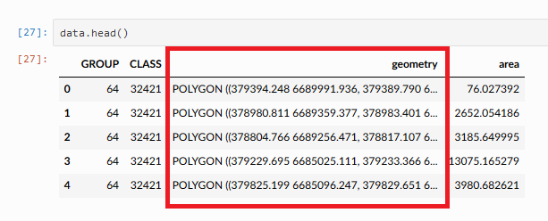
GeoPandas - Tabular Vector Data & Analysis
GeoPandas provides convenient data structures for manipulating and analyzing geographic data - the Geodataframe.
Supports reading and writing spatial data, spatial operations like joins and buffers, and basic visualization.

Slide 29

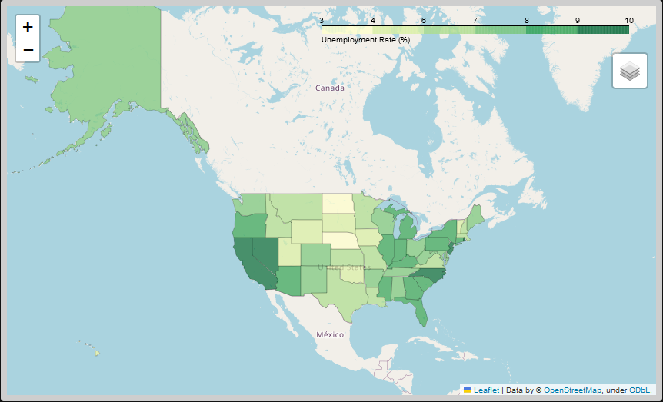
Folium - Interactive Mapping
Used to visualize data on an interactive leaflet map.
Enables both the binding of data to a map for choropleth visualizations as well as passing rich vector/raster/HTML visualizations as markers on the map.
Tons of base map options built in!

Slide 30
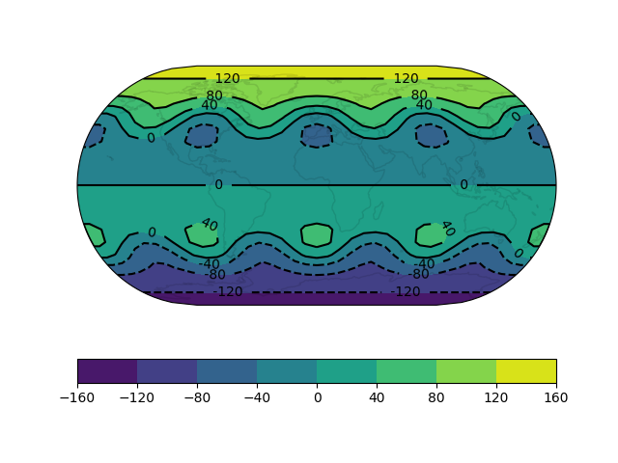
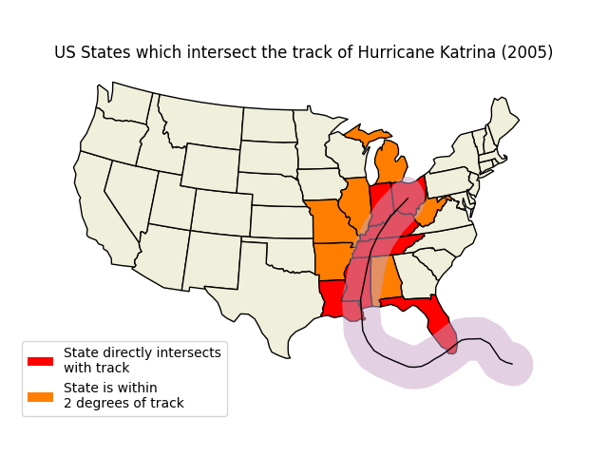
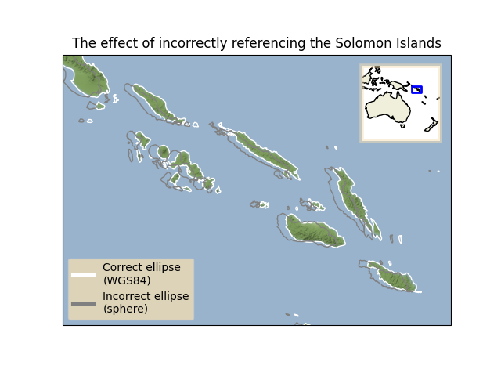
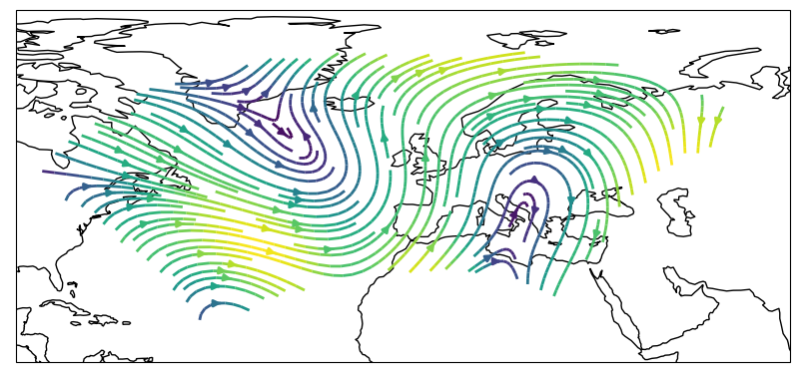
Cartopy - Mapping
Facilitates the creation of maps and spatial visualizations.
It provides an interface to the PROJ library (for handling projections and coordinate transformations) and other tools like shapely (for geometric objects).

Slide 31
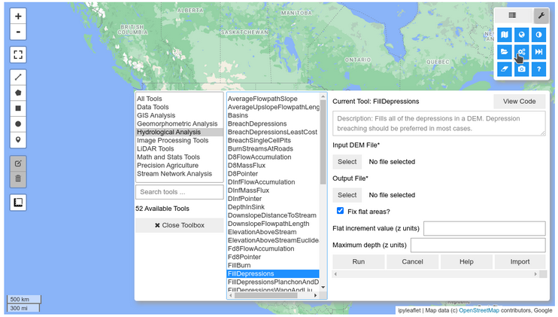

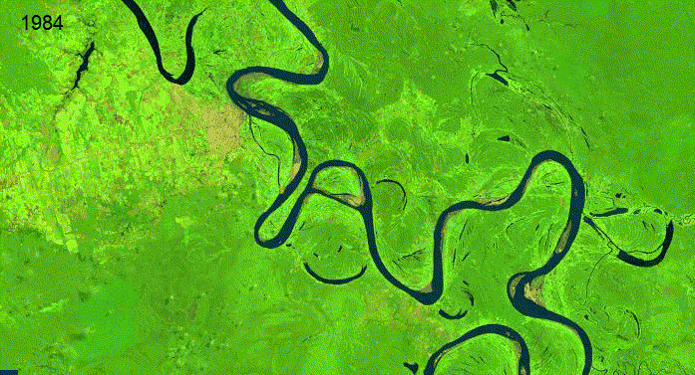
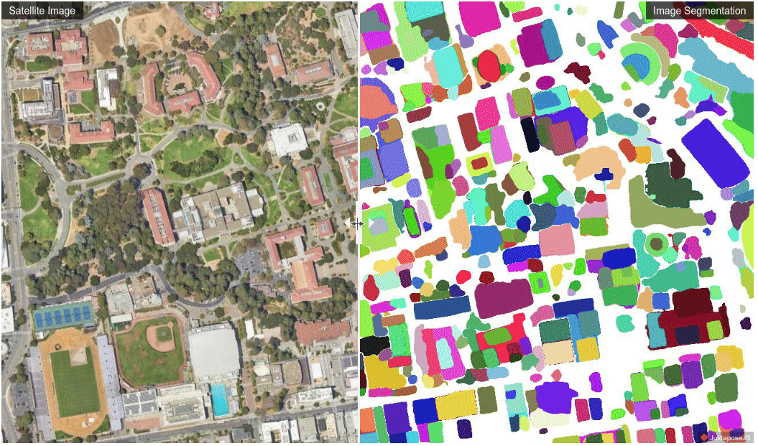
Leafmap - Better Mapping
For interactive mapping and geospatial analysis with minimal coding in a Jupyter environment.
A spin-off of the geemap package, which was designed specifically to work with Google Earth Engine.
Built in tooling for a GIS-like experience in a notebook!

Slide 32

Whitebox Tools - Full GIS in Python
Standalone geospatial analysis library that provides a large number of advanced geospatial algorithms.
This library was developed primarily to serve as a backend to the Whitebox Geospatial Analysis Tools (GAT) but is also suitable for use in other applications and scripts.
The package currently contains 395 tools, which are each grouped based on their main function into one of the following categories:
Data Tools, GIS Analysis, Hydrological Analysis, Image Analysis, LiDAR Analysis, Mathematical and Statistical Analysis, Stream Network Analysis, and Terrain Analysis.

Slide 33
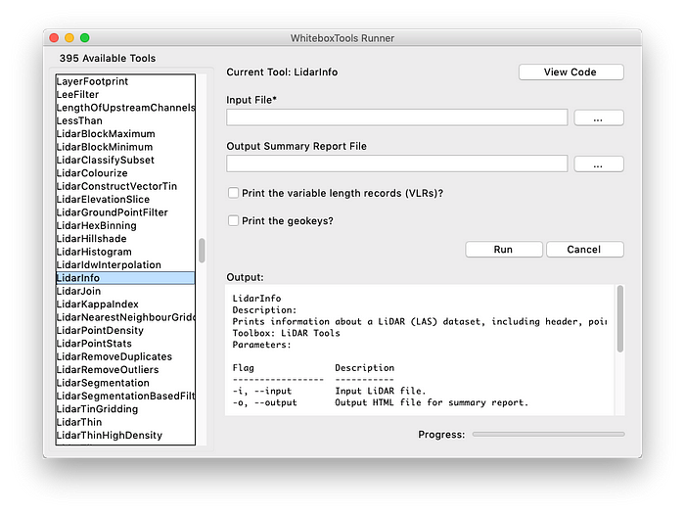

Whitebox Tools GUI

Slide 34

PySAL - Python Spatial Analysis Library
For spatial data science and spatial econometrics.
In 2018 it became a family of packages that bring together multiple aspects of spatial data science.
It offers a suite of spatial analysis functions designed to support the linkage, visualization, analysis, and modeling of spatial data.

Slide 35
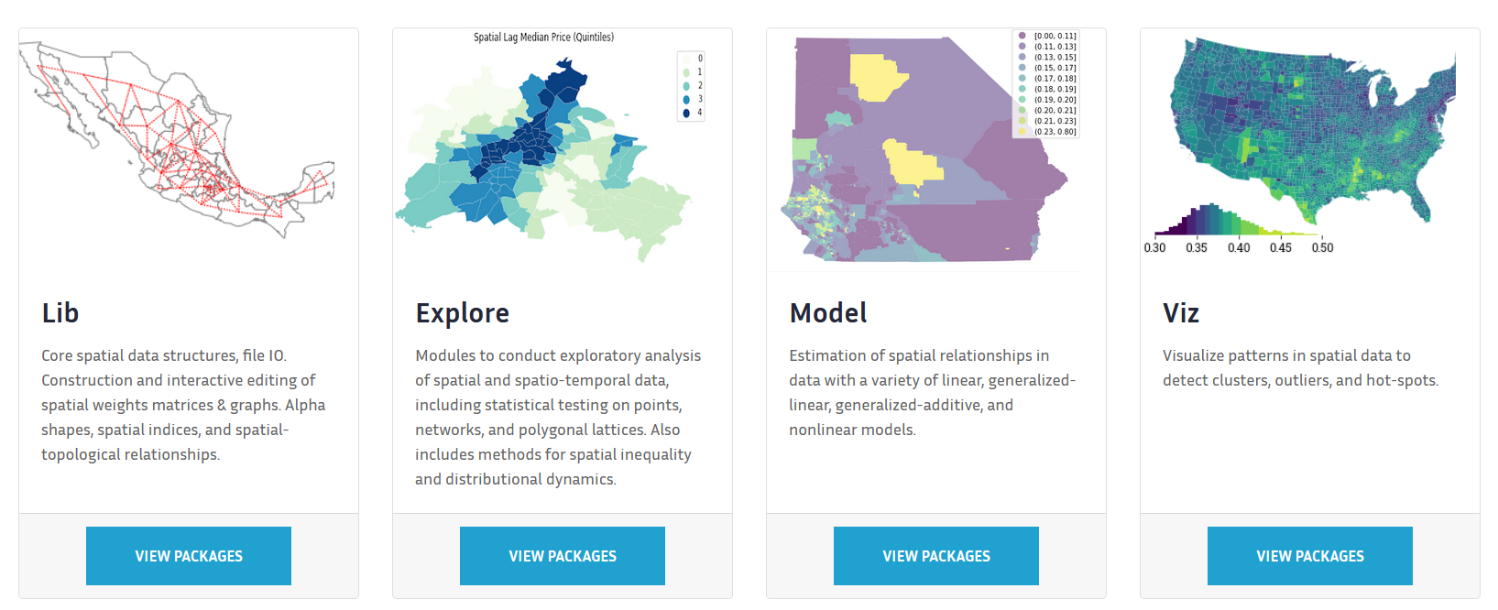
PySal Components
https://pysal.org/packages/

Slide 36
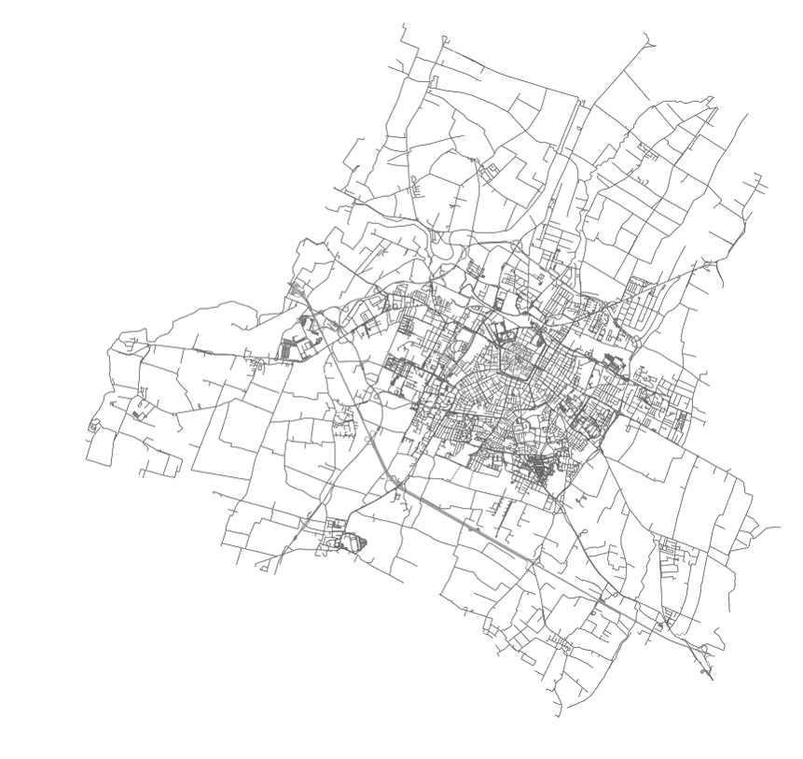
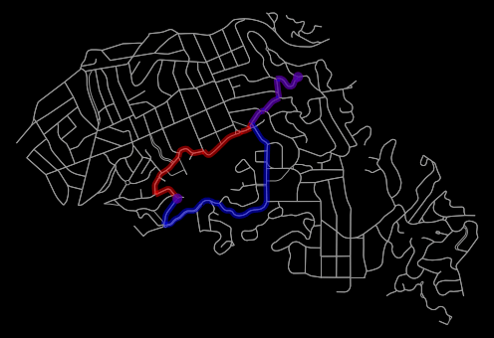
OSMnx & NetworkX
OSMnx is for downloading administrative boundary shapes and street networks from OpenStreetMap.
Can easily construct, project, visualize, and analyze complex street networks with the help of the NetworkX library.
Use Cases: urban planning, logistics, network analysis.

Slide 37
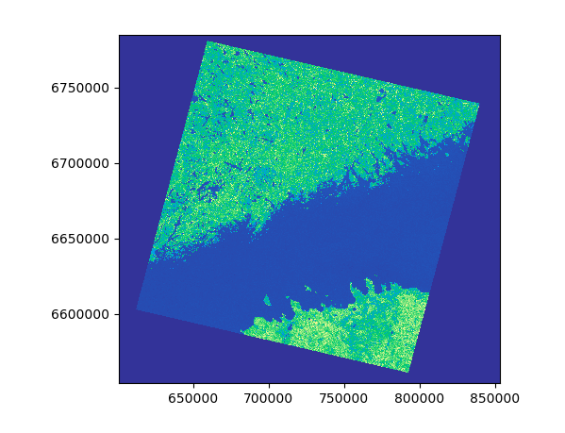
Rasterio - Raster Data & Analysis
Simplifies reading and writing geospatial raster datasets (like satellite imagery, digital elevation models, and more).
Built on top of the GDAL library, but offers a more "Pythonic" approach to raster data processing.
Can read & write raster files, resample, reproject, mask, clip, and much more!

Slide 38

Want to See Rasterio in Action?
Planet Labs did an excellent workshop at the Spatial Data Science Conference 2022 and has a notebooks available on github to explore!
https://github.com/planetlabs/notebooks/tree/master/jupyter-notebooks/sdsc-2022-workshop

Slide 39
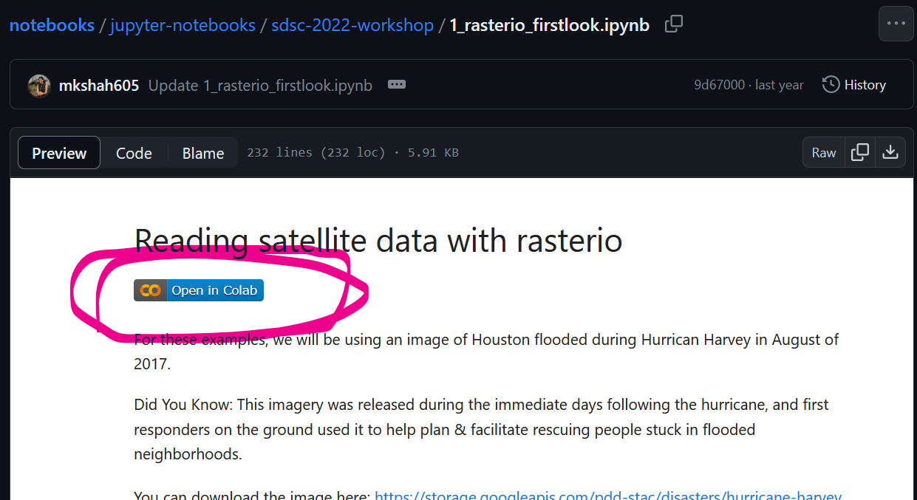
Can Open Planet Notebooks in Colab

Slide 40
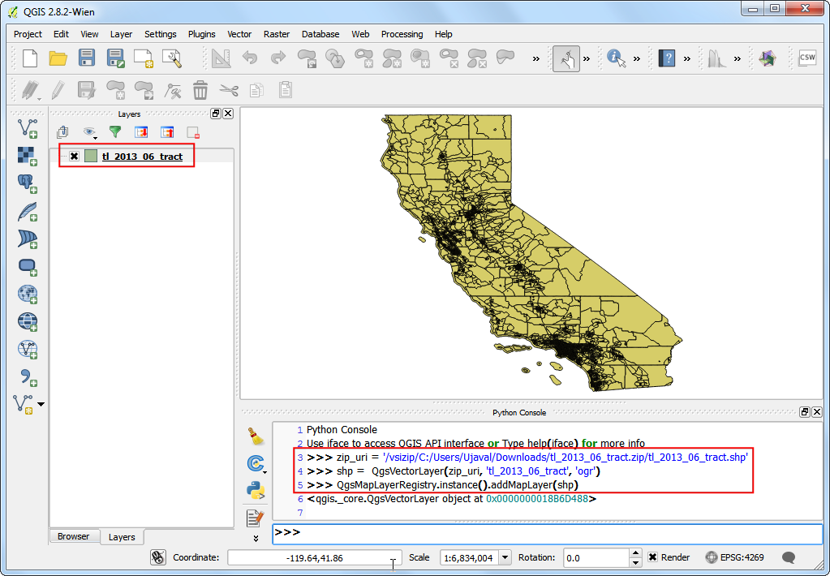


ArcPy & PyQGIS - GIS Interfaces
ArcPy and PyQGIS are Python libraries for automating Geographic Information System (GIS) tasks.

Slide 41
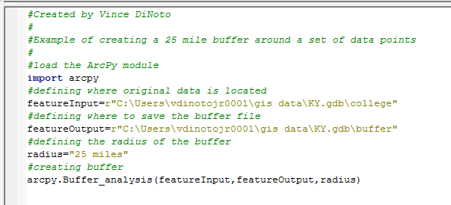
ArcPy in Action!

Slide 42


Honourable Mentions
Streamlit Geospatial - For building interactive dashboards with minimal code.
Apache Sedona - A cluster computing system for processing large-scale spatial data.

Slide 43
This is where the fun begins.
Hands on Geospatial Data Science

Slide 44
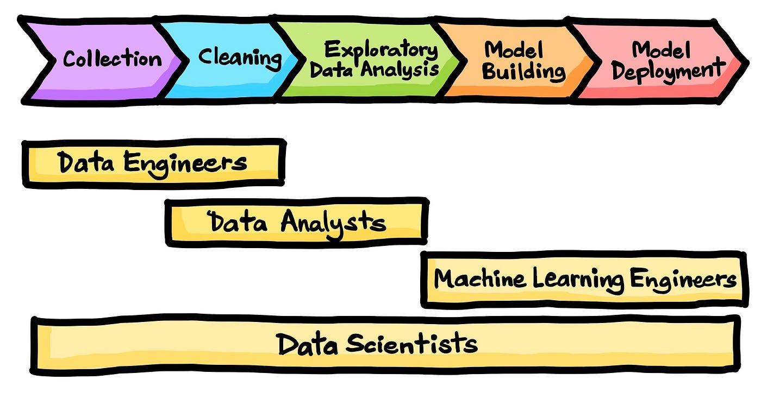
What We’ll Work on Today
Python can be used at each stage of the data science process.
Notes:
For the sake of time, we’ll focus on “Exploratory Data Analysis” and “Model Building”.

Slide 45
Popular Applications of Python We Won’t Cover
Desktop GIS Automation
Spatial Data Engineering
Artificial Intelligence - Machine Learning, Computer Vision, NLP
Working with raster data - such as satellite imagery
Notes:
There are multiple lifetimes of learning out there just within geospatial python, so we’re going to stick to the things we do everyday in our own roles.

Slide 46
Colab Link 2
https://tinyurl.com/spatialpythondemo
https://colab.research.google.com/drive/1t6HRqPV3MUqNuXvKz76d4IsN875e5h3L?usp=sharing

Slide 47
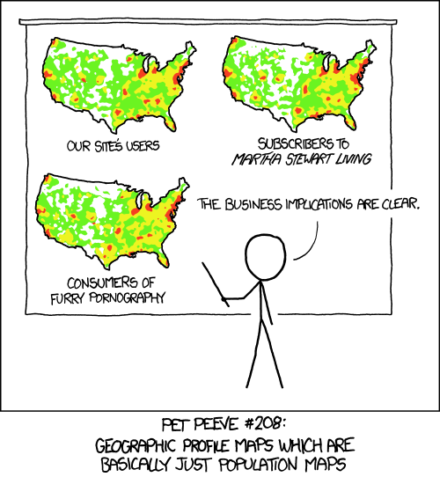
What We Don’t Want

Slide 48
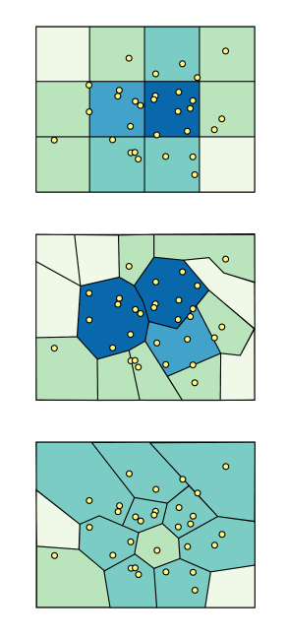
What is the Modifiable Areal Unit Problem?
A source of statistical bias in spatial analytics that can impact hypothesis testing.
Results of data aggregation are dependent on the mapmaker's choice of which "modifiable areal unit" to use in their analysis.
Using a uniform grid in your analysing of points can reduce the impact of this bias.
Book with more details:
https://mgimond.github.io/Spatial/pitfalls-to-avoid.html

Slide 49
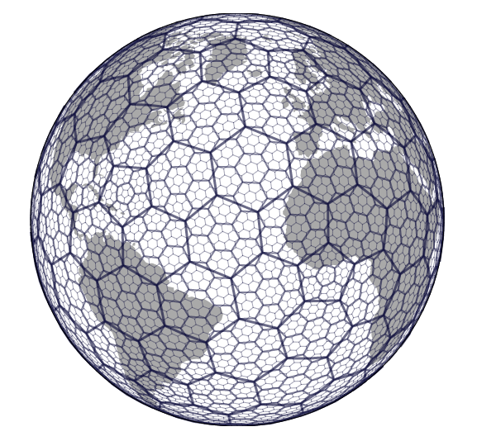
What is H3?
H3 is a “hexagonal hierarchical geospatial indexing system” developed by Uber.
Dividing the planet into hexagons at different scales to provide an even surface for analysis.
Making joining disparate spatial data easier and faster.
Supports a range of analysis options like nearest neighbors, shortest path, & gradient smoothing.

Slide 50
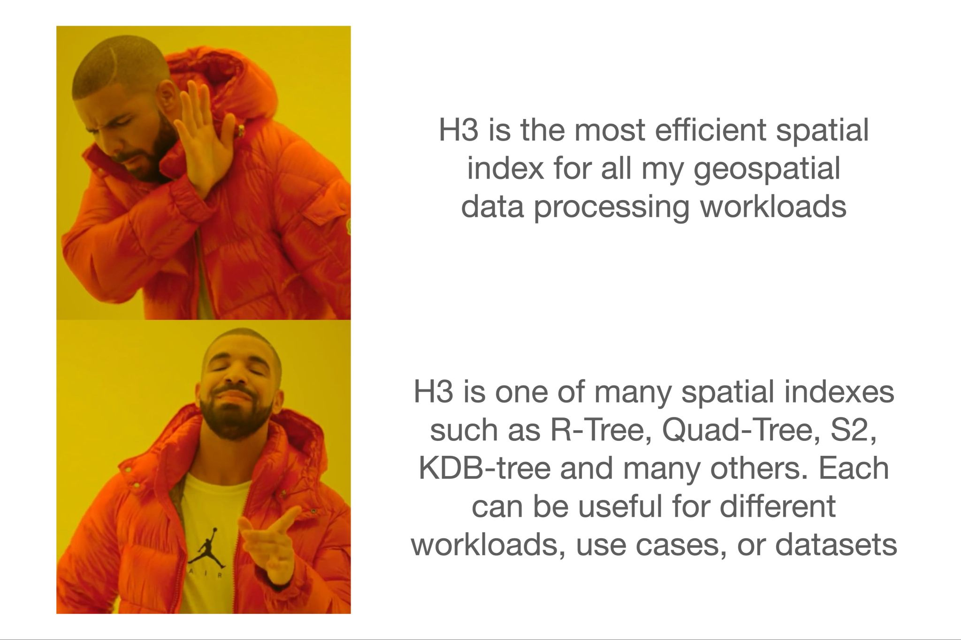
Why H3?

Slide 51
Thanks!
You can find us on LinkedIn or email us at:
thomas.j.lillo@gmail.com & jesse.terhorst@toronto.ca
We love a data challenge!
CREDITS: This presentation template was created by Slidesgo, including icons by Flaticon and infographics & imaged by Freepik

Slide 52
fin

